Slide 1
How to Input Public Education Activity Logs – a Step-by-Step Guide
May 2025
Notes:
This document is designed to help the Public Education Officer enter the activity logs into AUXDATA II to accurately reflect courses taught, time spent instructing, and the number of students. This material assumes that the member already has access to AUXDATA II and at least rudimentary knowledge of how to enter activity logs. If this assumption does not apply to you, see your Information Services Officer for training or take advantage of all the training material in the Information Technology Directorate.
If your district or division procedure is different, follow that policy.
This information is current as of May 10, 2025.

Slide 2
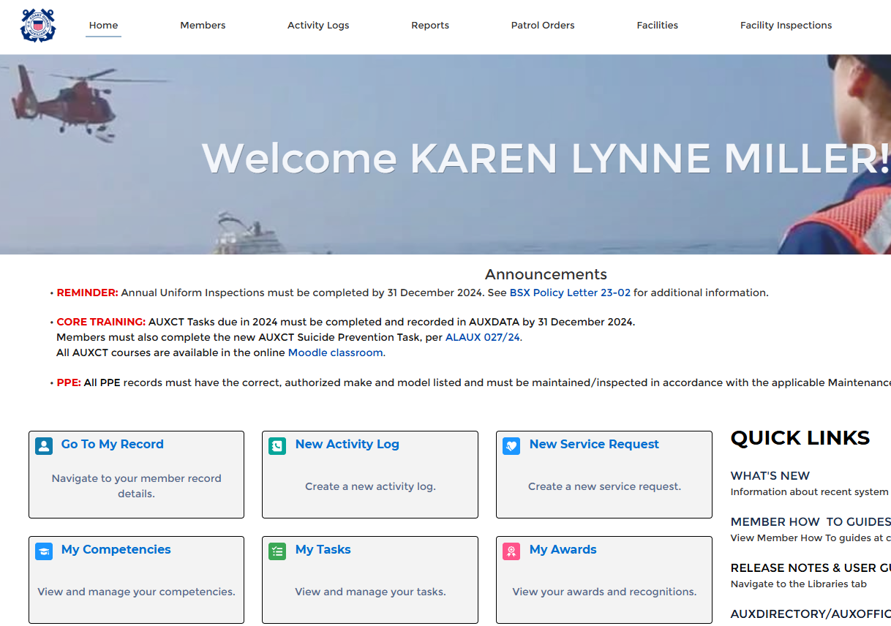
Your Home Page
Notes:
Your home page has a lot of interesting information. However, for this session, we are going to be concentrating on Activity Logs – the equivalent of what was known as the 7029, 7030, 7038, and 7046 under the legacy AUXDATA system. This session will look at the 7030 for Public Education classes.

Slide 3
Create a New Activity Log
Notes:
Below the welcome photo with your name, click on Activity Logs (see the green arrow).

Slide 4
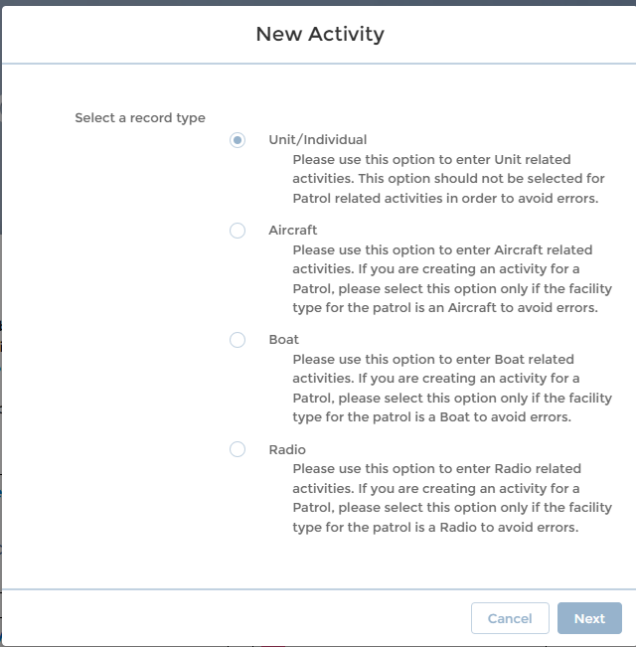
Select New Activity - Unit/Individual
Notes:
Select unit/individual (the default) and next.

Slide 5
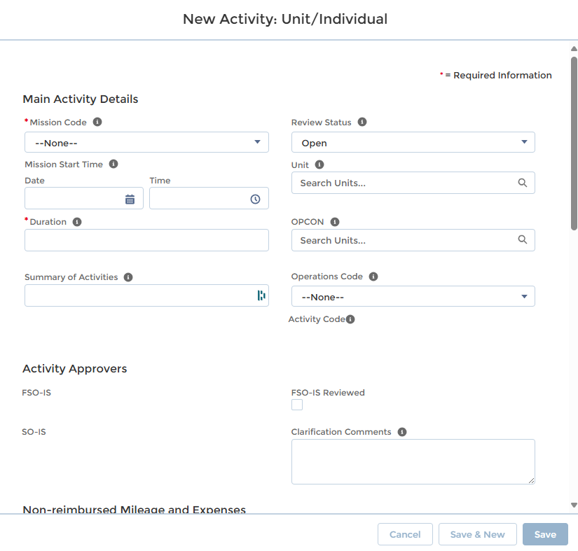
Entering Activity Information
Notes:
The info on the right side, unit, and OPCON will be filled in automatically once you save the entry information. If it fails, the unit is your flotilla, and OPCON should be your district.
On the top right side, leave the review status as open, ignore the operations code, and start your entry at Mission Code.

Slide 6
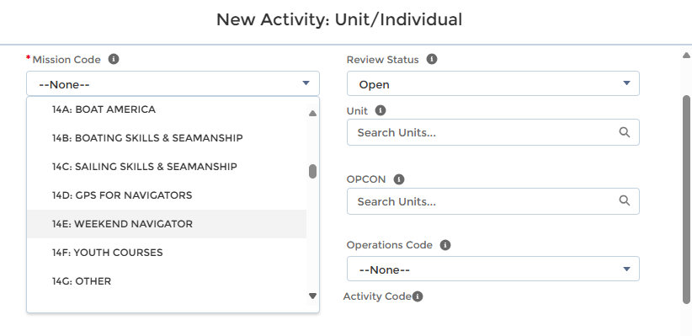
Entering Activity Information (continued)
Notes:
Mission Code for Public Education could be any of the following:
Code Course 14A Boat America 14B Boating Skills & Seamanship 14C Sailing Skills & Seamanship 14D GPS for Navigators 14E Weekend Navigator 14F Youth Courses 14G Other 14H State 14K Navegando America 14L Paddlesports America 14M Paddlers Guide to Safety 14N Intro to Basic Boating Safety 14P Suddenly in Command 14R Waterfowl Hunting & Boating Safety 14S Kids and Paddlecraft 14T Boats 'N Kids 14U Waypoints 14V Introduccion Seguridad Navegacion 14W Personal Watercraft Course
It is expected that a realignment of codes for Public Education will be implemented shortly. If that is the case, use the current codes that are available in the drop-down box.

Slide 7
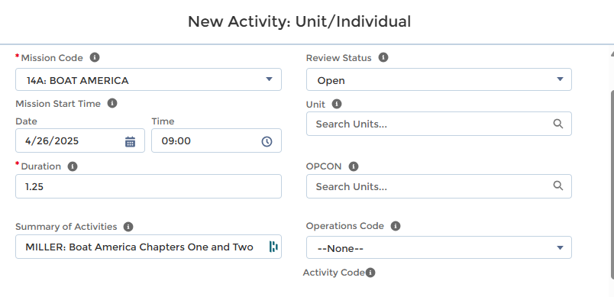
Entering Activity Information (continued)
Notes:
After entering the mission code, skip the activity code and select the Mission Start Date and Time. If the class is broken up into chapters taught by different instructors, you will have several entries for the entire course. For this exercise, we’ll demonstrate a Boat America class with different instructors for each chapter, along with a course moderator/aide. In this case, Karen Miller taught Chapters One and Two on April 26th, starting at 9:00 am and lasting one hour and 15 minutes.
See the next slide to learn how to correctly input the class duration when a session is not just a whole hour. In this example, the first two chapters of Boat America require one hour and 15 minutes (1.25 hours). Remember, an hour has 60 minutes when figuring the fractional minutes.

Slide 8
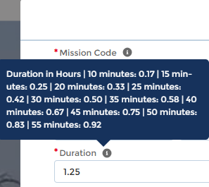
Entering Activity Information (continued)
Notes:
Notice the “i” in the circle by duration. If the class duration involves minutes rather than whole hours, left-clicking on the “i” will yield an information block breaking duration into five minutes increments.

Slide 9
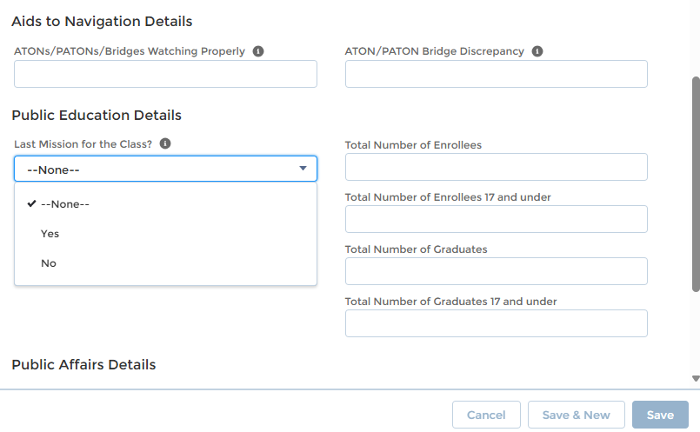
Entering Activity Information (continued)
Notes:
Now, scroll down this screen to the “Public Education Details” section. Unless this is the last class session, do NOT enter anything except respond to the Last Mission for the Class question. Since you will be entering information about the total enrollee, graduates, instruction method, and state on the last class ONLY, select no. This will not change until you enter the last class session, and then you’ll change it from No to Yes.
Once you select no, click save.

Slide 10
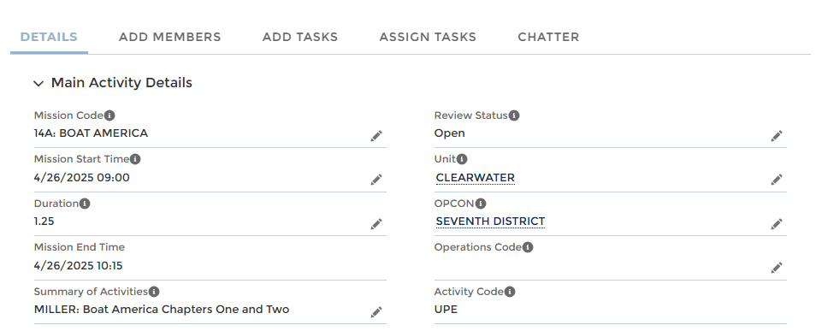
Entering Activity Information (continued)
Notes:
Click Save. Several things have happened when you click on save:
The activity is given an Activity Log Number (computer generated)
The unit and OPCON are automatically filled in
The activity code is filled in
Mission end time is calculated from the start date and time plus the duration.
Now go to the little pencil by Summary of Activities and click it. This will let you edit the screen. In this area, provide sufficient information that your Information Officer can determine what occurred. Always preface the summary with the instructor’s name.
But you’re not done!

Slide 11
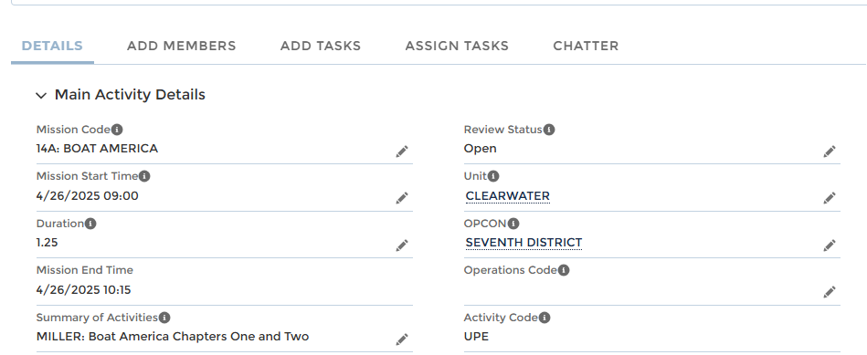
Entering Activity Information (continued)
Notes:
Even though you have pressed Save, you’re not done!
The system must know who was lead, non-lead, or trainee. It does not assume that you, entering the data, are the lead or even on the mission.
On the top left side of the screen, click on Add Member.

Slide 12
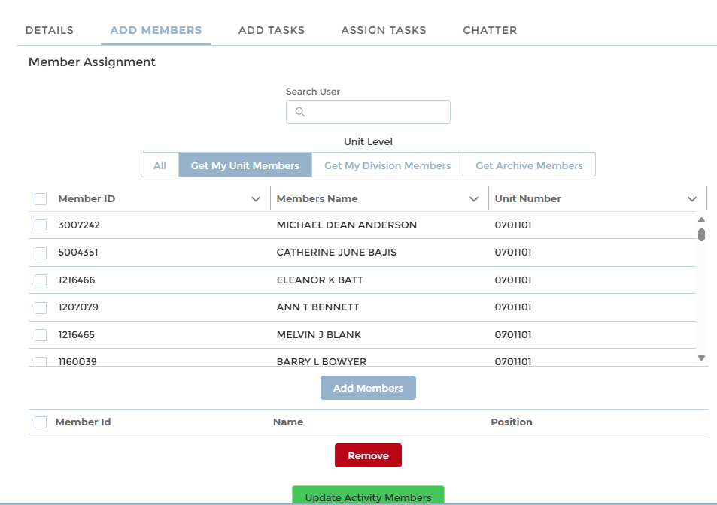
Entering Activity Information (continued)
Notes:
Notice the underline has moved from details to add member to let you know what screen you’re on.
When you first come to this screen, it will list all members of the CG Auxiliary, alphabetically. To find the instructor(s) for this class, you have several options:
You can go into the search user and put the member’s name or number and find the person that way. You can do this for each person who instructed or assisted that chapter. Once you see the member, click on Add Members.
If all the instructors are from your flotilla, you can select Get My Unit Members, and the system will show you all members of your flotilla. You can then select each member for this chapter. Once you see each one, click on the box to the left of their name(s) and click Add Members

Slide 13
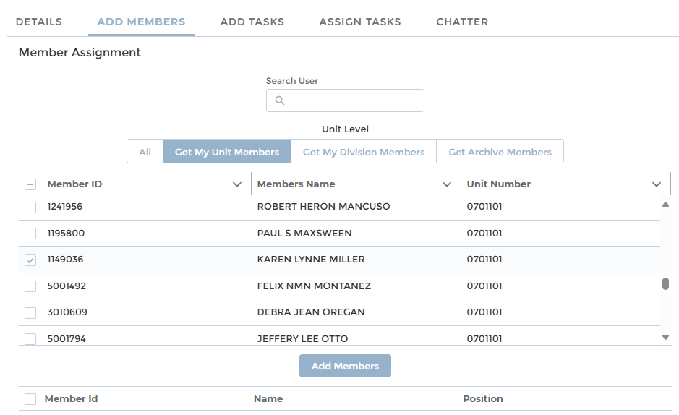
Entering Activity Information (continued)
Notes:
This slide shows selecting the member by clicking on the Get My Unit Members. Once the member is found, click the box on the left of that person’s name and select Add Member.

Slide 14
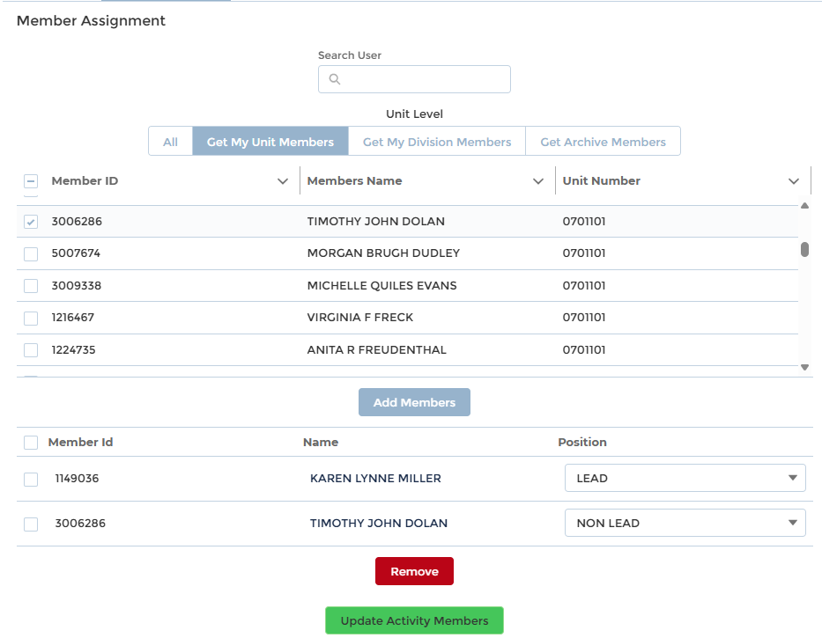
Entering Activity Information (continued)
Notes:
Once the member is found, click the box on the left of that person’s name and select Add Member.
MAKE SURE TO CHANGE EACH PERSON’S POSITION TO LEAD (an instructor who actually taught or supervised a trainee), NON-LEAD (an aide (this person does not have to be Instructor certified ) who helped with the class), or TRAINEE (a member who is going through the Instructor Development course and is doing their student teaching under the Lead instructor).
REMINDER: Hours spent as an Instructor for approved Public Education classes, including State and Youth Courses, are the only ones that go into AUXDATA II in the “14” category. The Lead Instructor MUST be qualified and listed as Lead. Aides and assistants do not have to be qualified and are entered as Non-leads. Separate Activity Logs should be entered if there are multiple Lead instructors, one for each Lead Instructor.
In this example, Karen Miller was lead instructor (corresponds to information provided on the first-details screen), and Timothy Dolan was an instructor aide (non-lead).

Slide 15
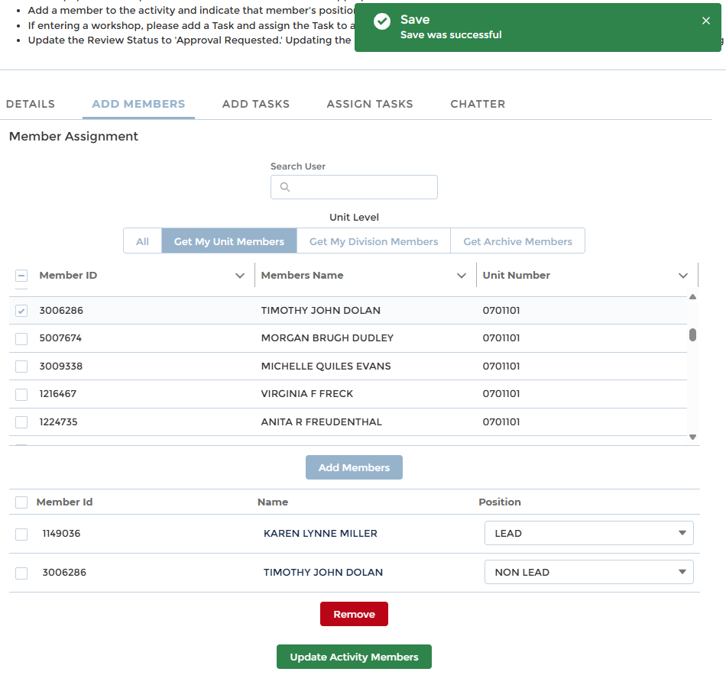
Entering Activity Information (continued)
Notes:
Once you have selected all the members appropriate for this chapter, click Update Activity Members. A green successful message should appear. If you erred, the message will be specific with what needs to be corrected.

Slide 16
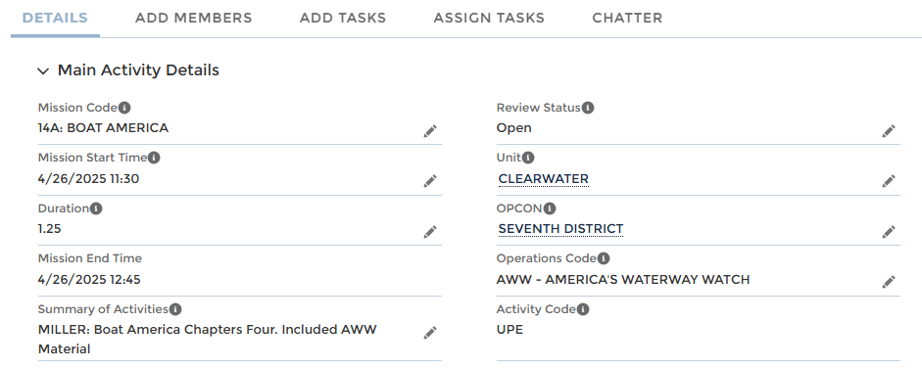
Entering America’s Waterway Watch
Notes:
If you teach a chapter that includes material or a video on America’s Waterway Watch, click on the Operations Code and select AWW. This is important for the information that is provided to the Coast Guard on our missions.

Slide 17
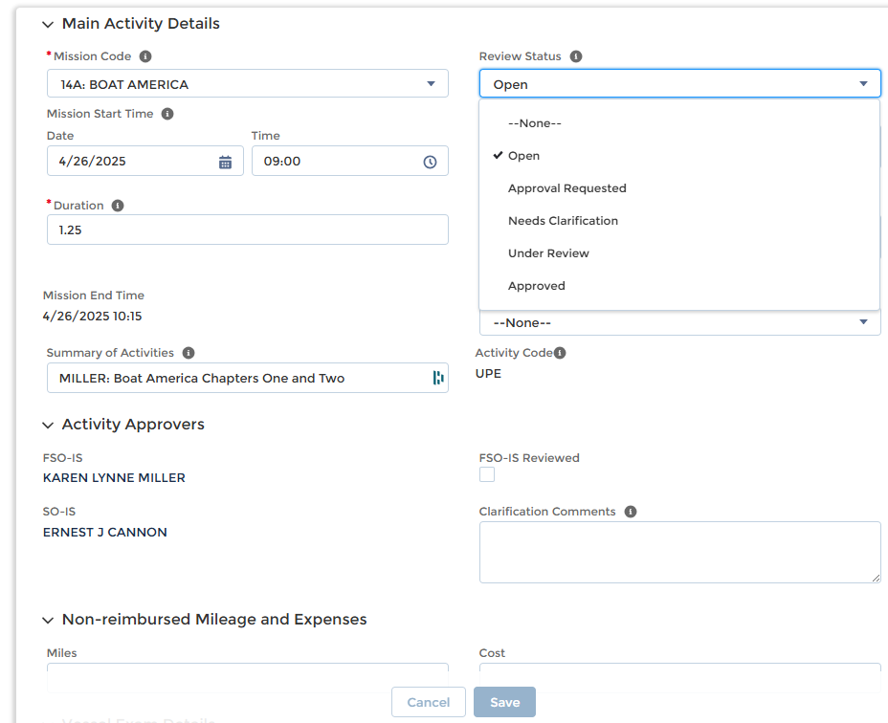
Entering Activity Information (continued)
Notes:
Return to Details in that top row. Check your work. If you made an error, any field with a pencil allows you to edit that field.
Once you are sure everything is correct, click the pencil to the right of review status, click the down arrow, and change it to Approval Requested.
Then click SAVE.
If you conduct another class that day with different instructors or aides, you need to create another activity log. Click new, and go back to slide 4, and follow the procedure.
NOTE: Cloning is not available for these missions.

Slide 18
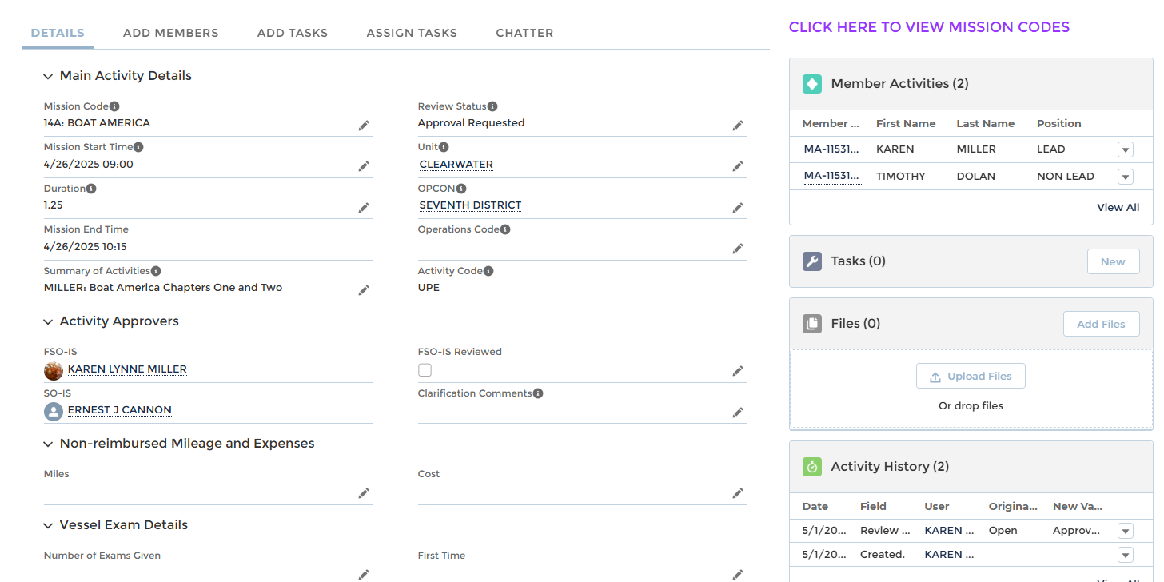
Entering Activity Information (continued)
Notes:
Once you select Save and Approval Requested or even leave it as Open, you will be returned to the Activity Log screen, and any activities you recently generated will be under Recently Viewed.

Slide 19
Entering Activity Information (continued)
Notes:
Once you select Save and Approval Requested or even leave it as Open, you will be returned to the Activity Log screen, and any activities you recently generated will be under recently viewed.
Then, you can enter a new activity log.

Slide 20
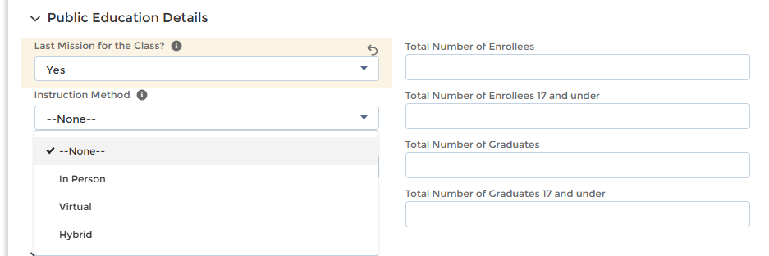
Entering the Last PE Mission
On the last PE mission ONLY, enter the student information
Notes:
Once you have entered each of the classes/chapters and all the information described in the prior slides, on the last activity log you are entering for this course, scroll down the screen until you come to Public Education Details. Click on the pencil to the right of the first item and enter the information requested.
Remember to include the student count information on the last activity record for the last day or night of the entire series of classes.
REMEMBER to change the last mission question to Yes.

Slide 21
Entering the Last PE Mission
On the last PE mission ONLY, enter the student information
Notes:
Once you have entered each of the classes/chapters and all the information described in the prior slides, on the last activity log you are entering for this course, scroll down the screen until you come to Public Education Details. Click on the pencil to the right of the first item and enter the information requested.
Remember to include the student count information on the last activity record for the last day or night of the entire series of classes.
REMEMBER to change the last mission question to Yes.
Once you are sure the information is correct, scroll back up, change the review status to approval requested, and click save.
Instructor Travel and Preparation time for the PE class should be reported on their 7029 with mission code 99B

Slide 22
AUXDATA II How to Input Public Education Activity Logs
Thank you
Have Feedback?
You may email the E-Directorate at pe.feedback@cgauxnet.us

